Slide 1
Decluttering
The 1st Step in Restoring Order
A Mini-Presentation by
Inspector Ross Personal Consultant
www.inspectorross.com.au

Slide 2
What is Clutter?
Not just ‘stuff’ -- it’s whatever defeats your
values or serves no desirable purpose for:
The task at hand
The day
The week
A whole project, or
A life goal.
Have you seen examples of this kind of clutter? Not yours, of course, but...

Slide 3
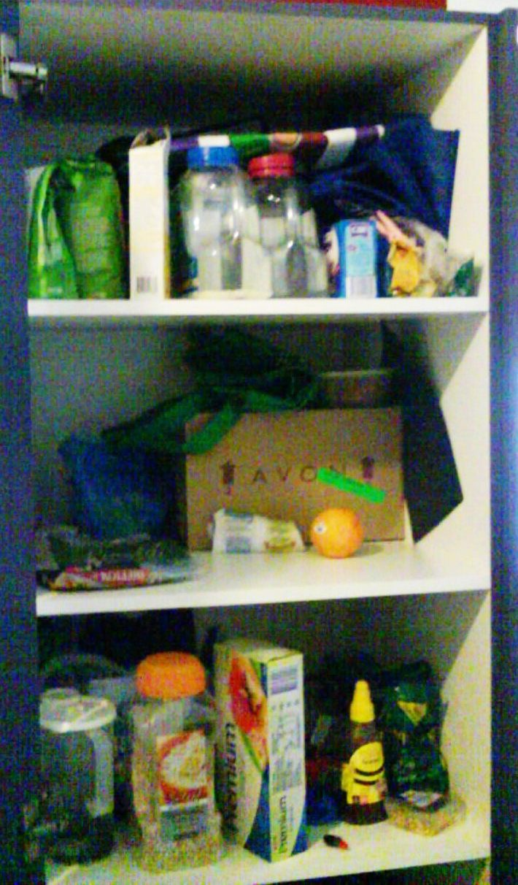
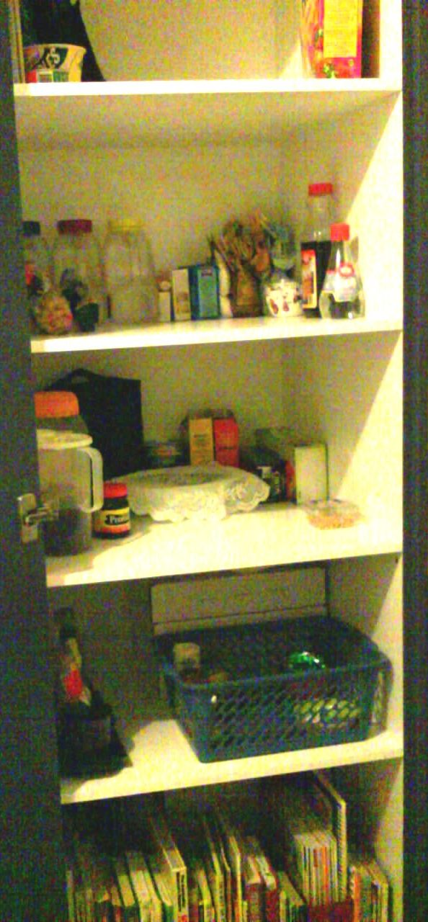
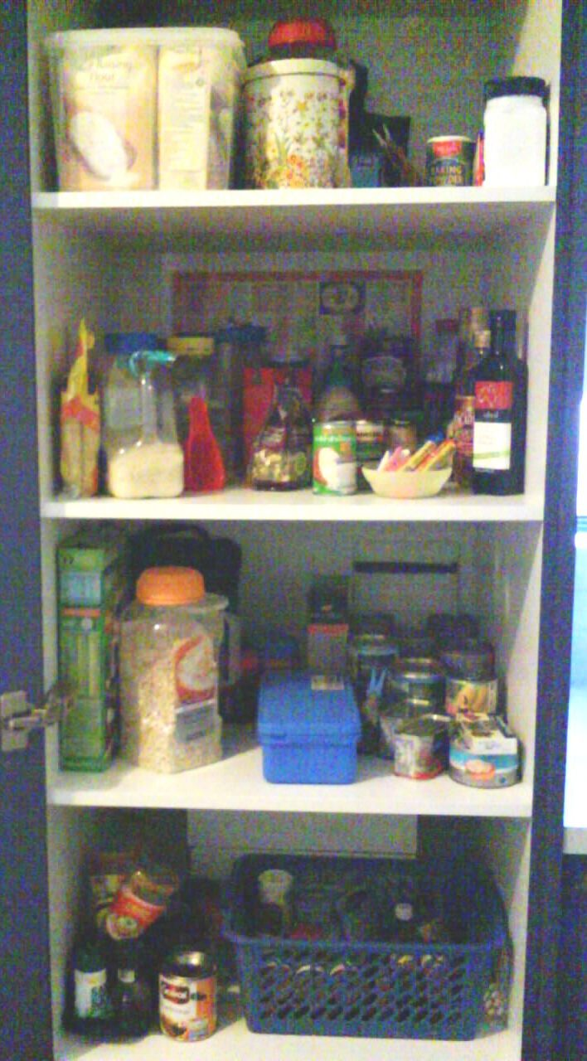
Sample on Economy Budget: Pantry B4, After & Re-stocked

Slide 4
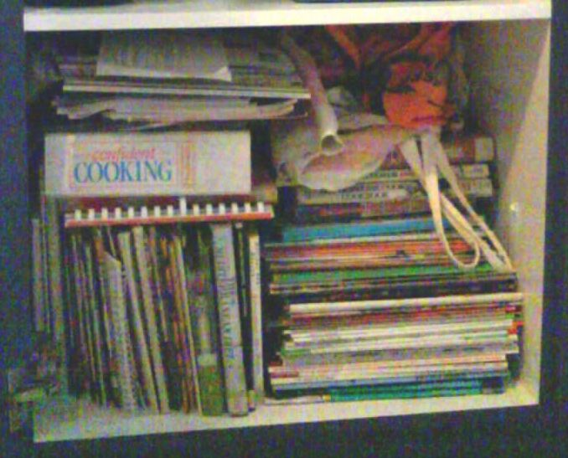
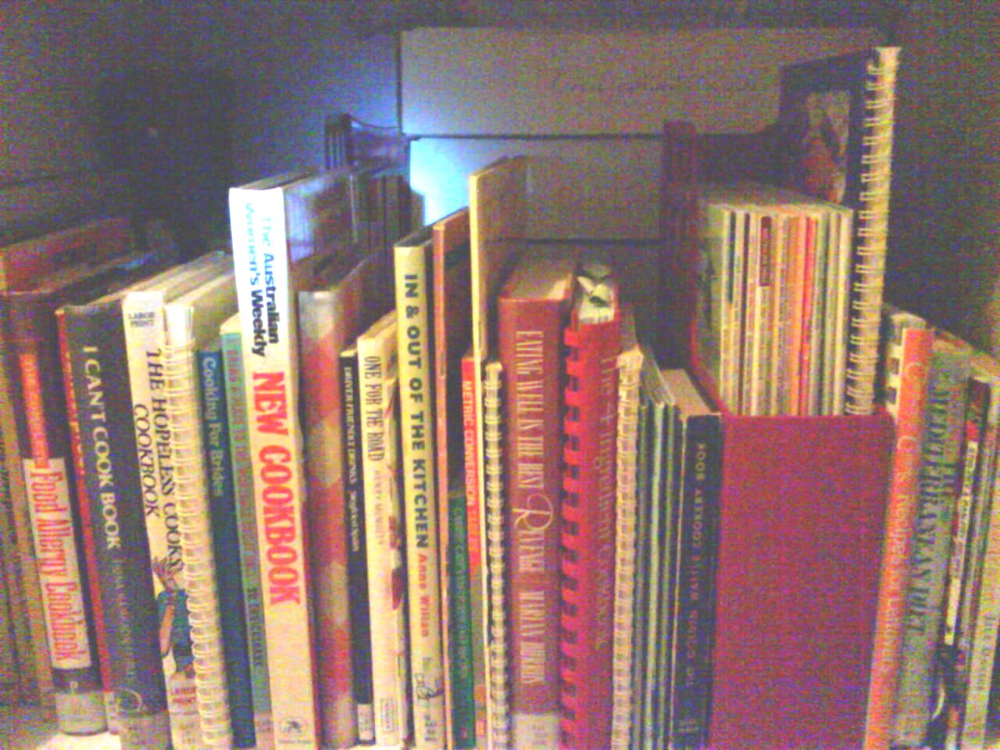
Cookbooks Bottom pantry shelf: less-used cookbooks (etc.!) b4 & after -- now arranged L-R in groups of declining usage, with out-of-season recipe books at back, & irrelevant items removed. Note: Organise books & papers for use over appearance.
Notes:
With books & papers, it’s important to organise them for use over appearance. Exceptions could be books you’ve already read but want to keep for decoration or sentimental value, etc. In that case, organise them prettily by all means!

Slide 5
Have a Go Yourself, on a Small Area using the Rapid-Sort Method
Set up 3 containers for worthwhile items.
A 4th for ‘Trash’
A 5th for Undecided
KEEP
HERE
KEEP
ELSE-
WHERE
RECYCLE
UNDECIDED
DISCARD
(Trash)

Slide 6
Put Away the Keeps & Tidy Up, Using Straight Lines & Right Angles
A quick technique to reduce visual
clutter – can get imaginative later.
Looks neat
Highlights clutter creeping in
Creates an atmosphere of user respect, so systems may stay in!

Slide 7
Dispose of Discards & Recycling
If possible, physically do this yourself – this can be the most rewarding part ☺
For recycling destinations, consult:
Local council
www.recyclingnearyou.com.au

Slide 8
Please contact me if you’d like help with any stage of your organising project.
Heidi,
Inspector Ross
www.inspectorross.com.au

